Slide 1


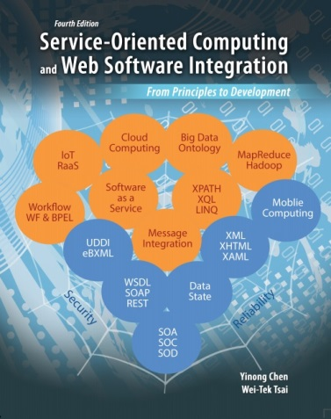
CSE 445/598
Distributed Software Development
Chapter 3
Essentials in Service-Oriented Software Development
Reading: Text Chapter 3

Slide 2
Chapter 3 Outline
Overview of SOA Development Platforms
Basic ASP .Net Web Services and Applications
Service development
Service hosting
Service registration
Application building
Java-based Development
Service development
Lecture 10
ASP .Net service (.asmx)
WCF service (.svc)
RESTful service
Workflow service (.xamlx)
Lecture 11
Lecture 12
Lecture 13

Slide 3
Overview of SOA Software Development
ASP.NET Web Services (a.k.a. ASMX);
.NET Remoting;
Enterprise Services (the successor to COM+);
Web Services Enhancements (WSE);
Microsoft Message Queuing (MSMQ);
Windows Communication Foundation (WCF);
Java-based SOA Development: Eclipse/Axis/Tomcat
Oracle/JDeveloper (text chapter 8)
Websphere (IBM)
SCA/SDO (IBM and others)

Slide 4
Service Development Frameworks and Features
Service Development Environment | Platform- independent Web service | Platform- dependent service | Distributed transactions | WS-* specification (e.g., reliability and security) | Primary language supported
ASMX (ASP .Net) | X |  |  |  | C# / VB
.Net Remoting |  | X |  |  | C#
Services: BizTalk |  |  | X |  | XLang / BPEL
WSE: WS Enhancements | X |  |  | X | C# / VB
WCF | X | X | X | X | C# / VB
AJAX | X |  |  |  | Java Script
Eclipse / Axis / Tomcat | X |  | X | X | Java
JEE: Java Edition | X | X | X | X | Java / Java Script / JavaBeans
NetBeans | X | X | X | X | BPEL
JDeveloper / Oracle SOA Suite |  |  | X | X | BPEL
WebSphere |  |  | X | X | BPEL / Java

Slide 5
As a Service Provider
Develop Web Services Using
ASP .Net
WCF
Java Platforms
Service brokers
Registry
ASP .Net services: .asmx
Registry
WCF services: .svc WSDL/SOAP
Different programming interfaces, but the same WSDL interface
Application builder
Service providers
Applications
Class / Object
WCF services: RESTful
Java services

Slide 6
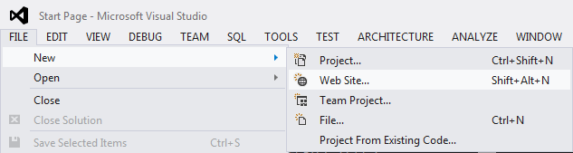
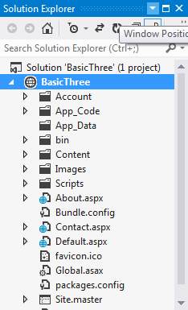
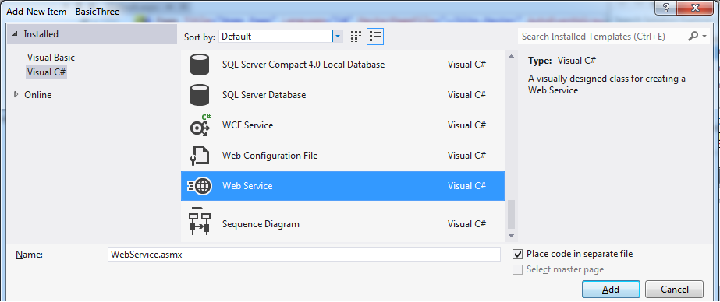
Develop Web Services Using ASP .Net
Create a new Website application
Right-click to add a .asmx service

Slide 7
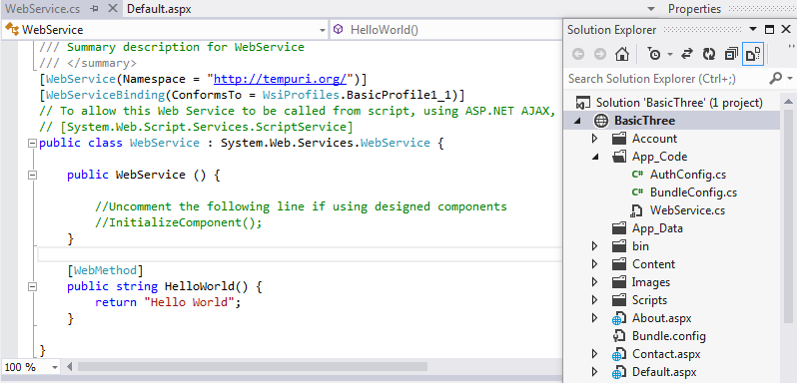
Developing a .asmx Web Service

Slide 8
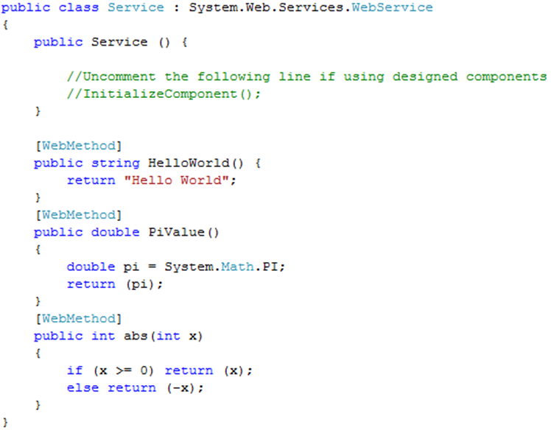

Add Your Own Functions

Slide 9
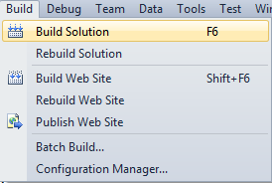
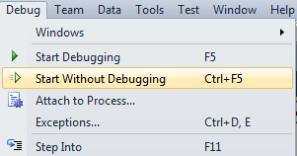
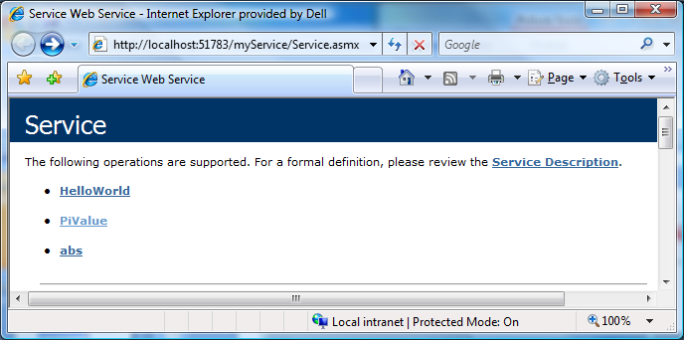
The Web Service (.asmx file) are Created

Slide 10
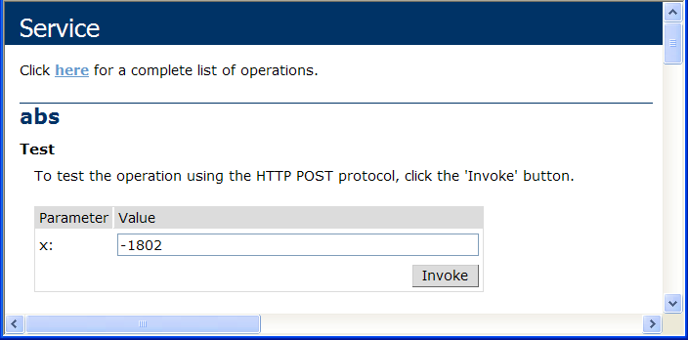
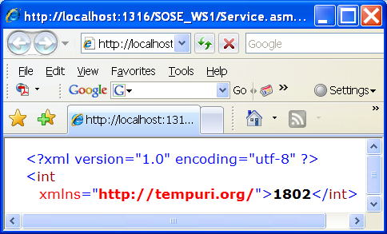
Test Services: You entered the service function

Slide 11



Developing Web Services (.svc) in Windows Communication Foundation New Standard Recommended in .Net 4.x, replaces .asmx services
.asmx services are obsolete. You will not develop new .asmx services, but you will still use existing .asmx services that have been deployed
WCF Service.svc
WCF Client
Endpoint
A
B
C
Proxy
Endpoint
A
B
C
A
B
C
Endpoint
HTTP/S and others
A
B
C
Address
(where)
Binding
(how)
Contract
(what)
Endpoint/Proxy

Slide 12
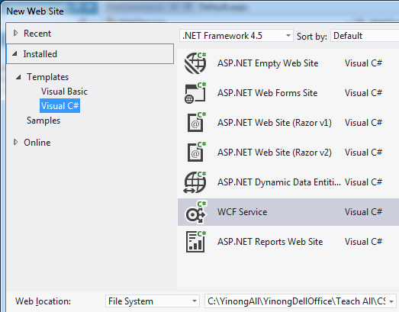
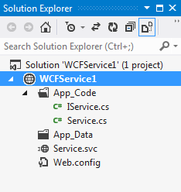
Develop Web Services Using WCF
Text Chapter 3, section 3.2.1
You did this exercise in assignment 1

Slide 13
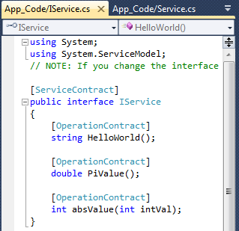
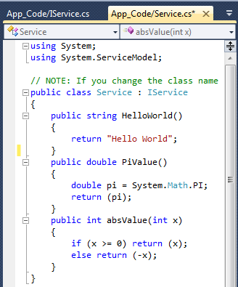
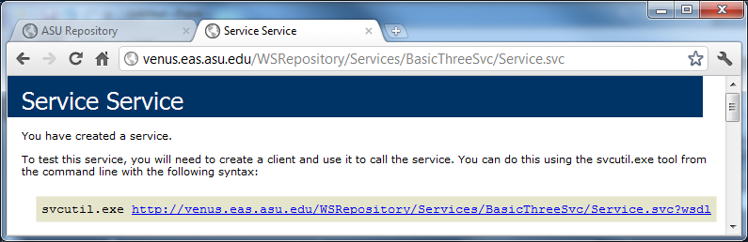
IService.cs and Service.cs Files
Address
(where)
Binding
(how)
Contract
(what)
Endpoint/Proxy

Slide 14
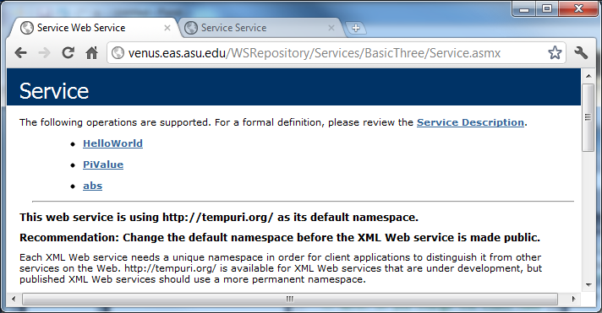
Difference between .asmx and .svc services

Slide 15
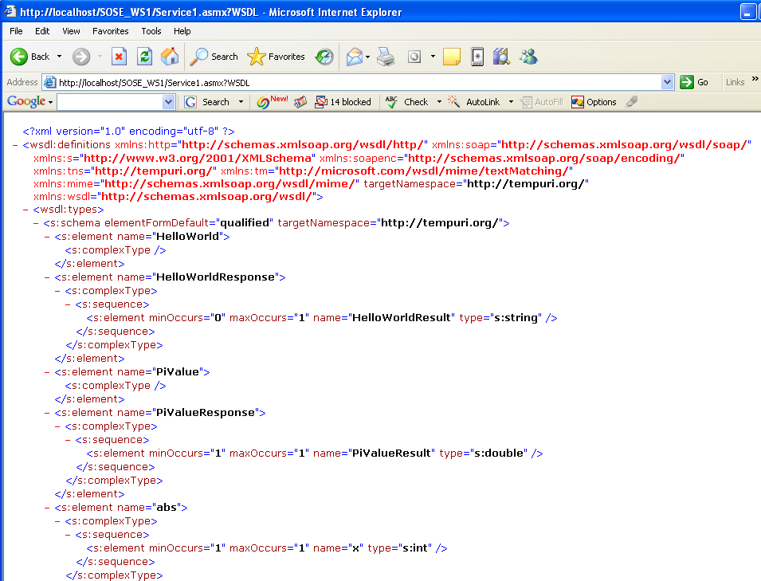
The language interfaces of .asmx and .svc services are different, but both have the same WSDL interface for remote accesses.

Slide 16
WSDL: Web Service Description Language
WSDL is used to describe Web services, including four critical aspects of Web services:
Functionality description of the services in standard taxonomy;
Contract of parameter types and return type of the function (service) calls;
Binding information about the transport protocol to be used, usually, SOAP;
Address information for locating the specified service.
The last three aspects can be automatically generated.
Web services described in WSDL can be searched, matched with the requirement.
Web services described in WSDL provides the remote call detail.

Slide 17
Logical Structure of WSDL Document’s Elements
definitions, with a name and namespaces used
A namespace of classes
A class
service
service
Address
port
(URL)
endpoints
port
(URL)
Binding
. . .
Multiple methods
binding
(soap)
binding
(soap)
Method name of the class
portType
portType
operation
operation
Method parameter types
Contract
message, in
. . .
message, in
types
types
Method return type
message, out
message, out
types
types

Slide 18
WSDL Example: Get Stock Quote
http://www.w3.org/TR/wsdl
The example shows the WSDL definition of a simple service providing stock quotes.
The service supports a single operation called GetLastTradePrice, which is deployed using the SOAP protocol over HTTP.
The request takes a string (type) as input, and returns the price as a float (type).

Slide 19
WSDL Example: Organization of the Code
definitions
<?xml version="1.0"?>
<definitions name="StockQuote"
(namespaces used)
<types> ... </types>
<messages> … </messages>
<portType>
<operation> … </operation>
</portType>
<binding> … </binding>
<service>
<port> … </port>
</service>
</definitions>
service
Port
(URL)
. . .
Binding
(soap)
PortType
Operation
Message, in
Types
Message, out
Types

Slide 20
WSDL Code Example (Namespaces)
Namespaces link to external definitions
Root node
Declare Namespaces and qualifiers
<?xml version="1.0"?>
<definitions name="StockQuote" targetNamespace="http://example.com/stockquote.wsdl"
xmlns:tns="http://example.com/stockquote.wsdl"
xmlns:xsd1="http://example.com/stockquote.xsd"
xmlns:soap="http://schemas.xmlsoap.org/wsdl/soap/"
xmlns="http://schemas.xmlsoap.org/wsdl/">
<types>
...
</types>
Put types definition in a separate page
Or, the types could be defined here
Qualifiers to define the scope

Slide 21
WSDL Code Example (TypeDef)
The types are defined in "http://example.com/stockquote.xsd"
<types>
<schema targetNamespace="http://example.com/stockquote.xsd"
xmlns="http://www.w3.org/2000/10/XMLSchema">
<element name="TradePriceRequest">
<complexType>
<all> <element name="tickerSymbol" type="string"/> </all>
</complexType>
</element>
<element name="TradePrice">
<complexType>
<all> <element name="price" type="float"/></all>
</complexType>
</element>
</schema>
</types>
①
②
Typedef in C/C++
typedef TradePriceRequest string;
typedef TradePrice float;

Slide 22
WSDL Code Example (message & portType)
<message name="GetLastTradePriceInput">
<part name=“body”
element="xsd1:TradePriceRequest"/>
</message>
<message name="GetLastTradePriceOutput">
<part name=“body” element="xsd1:TradePrice"/>
</message>
<portType name="StockQuotePortType">
<operation name="GetLastTradePrice">
<input message="tns:GetLastTradePriceInput"/>
<output message="tns:GetLastTradePriceOutput"/>
</operation>
</portType>
①
②
Use type to define variables
Address
(where)
Binding
(how)
Contract
(what)

Slide 23
WSDL Code Example (binding via soap)
<binding name=“StockQuoteSoapBinding” type="tns:StockQuotePortType">
<soap:binding style="document"
transport= "http://schemas.xmlsoap.org/soap/http"/>
<operation name="GetLastTradePrice">
<soap:operation soapAction=
"http://example.com/GetLastTradePrice"/>
<input> <soap:body use="literal"/></input>
<output> <soap:body use="literal"/></output>
</operation>
</binding>
Address
(where)
Binding
(how)
Contract
(what)

Slide 24
WSDL Code Example (service & port)
<service name="StockQuoteService">
<documentation>
This service offers latest stock quotes
</documentation>
<port name="StockQuotePort" binding= "tns:StockQuoteBinding">
<soap:address location= "http://example.com/stockquote"/>
</port>
</service>
</definitions>
Address
(where)
Binding
(how)
Contract
(what)

Slide 25
Names of Elements
definitions: name="StockQuote“, namespaces
service: name="StockQuoteService">
port
name="StockQuotePort"
binding
name=“StockQuoteSoapBinding” <binding style="document"/> …
portType: name=“StockQuotePortType”
operation: name=“GetLastTradePrice”
message: name=“GetLastTradePriceInput”>
types: TradePriceRequest
message, name="GetLastTradePriceOutput">
types: TradePrice

Slide 26
Abstraction and Flexibility of Elements
definitions
port definition is abstract; binding will be used to specify a concrete protocol. This allows
ports to be separated from their implementation detail regarding network deployment or bindings;
the reuse of Port definition in different apps.
message definition is abstract: abstract descriptions of the data being exchanged; types are used to associate specific data types to the messages. This allows
messages are separated from their implementation detail of data format;
the reuse of message definition;
wrap multiple parameters in the message
service
port
(URL)
. . .
binding
(soap)
portType
operation
message, in
types
message, out
types

Slide 27
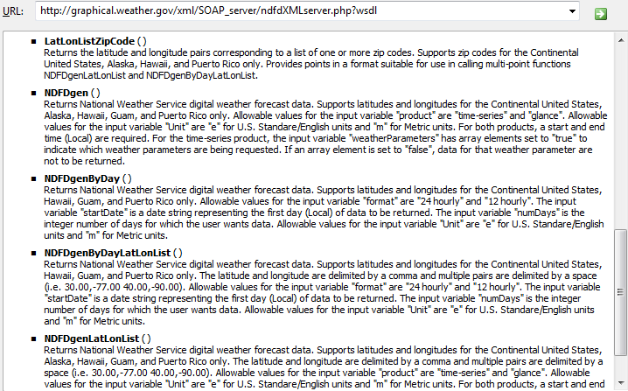
U.S. National Weather Forecast Service
http://graphical.weather.gov/xml/SOAP_server/ndfdXMLserver.php?wsdl
zipcode1, …, zipcoden → (lat1, lon1), …, (latn, lonn)

Slide 28
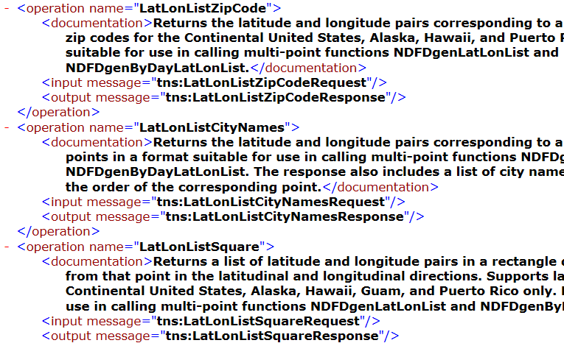
http://graphical.weather.gov/xml/SOAP_server/ndfdXMLserver.php?wsdl

Slide 29
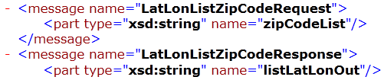
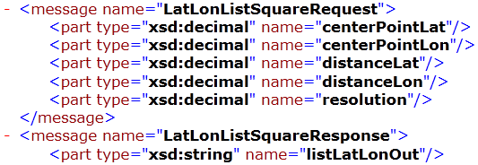
Type Definition of the Operations
More detail of the service and its operations are at:
http://graphical.weather.gov/xml/
http://graphical.weather.gov/xml/SOAP_server/ndfdXMLserver.php

Slide 30
From WSDL/SOAP to RESTful Services
Use
WSDL / SOAP / HTTP
WSDL services
SOAP Services
WSDL/SOAP services
.asmx services
.svc services
Services
Use HTTP Only
RESTful Services

Slide 31
Developing RESTful Services
Services
Use HTTP Only
RESTful Services
There are different ways of developing RESTful services. We show one way here: Convert a WSDL/SOAP service into a RESTful service.
CSE446 (Text Part II) will discuss more detail of RESTful services

Slide 32
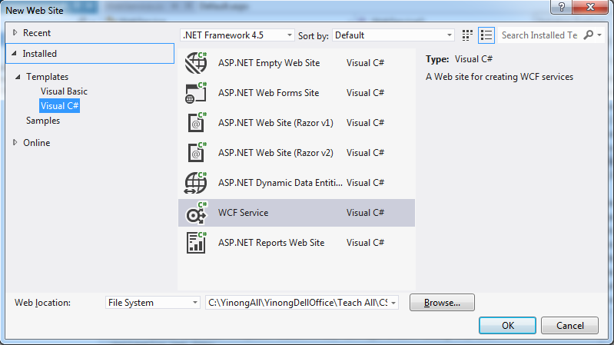
Developing a RESTful Service
In Visual Studio menu, choose New Web Site
Choose C# template, and choose “WCF Service”.
Name the project WcfRestService3.

Slide 33
Developing WCF-Based RESTful Service
The template creates standard WCF service files, including
Iservice.cs inteface
Service.cs file
Service.svc file

Slide 34
Add HTTP method: [WebGet] in IService.cs:
using System;
using System.ServiceModel;
using System.ServiceModel.Web;
[ServiceContract]
public interface Iservice {
[OperationContract]
[WebGet] // Add this HTTP GET attribute/directive, use default format
double PiValue();
[OperationContract]
[WebGet(UriTemplate = “absValue?x={x}”)] // define input format
int absValue(int x);
[OperationContract]
[WebGet(UriTemplate = “add2?x={x}&y={y}”)] // define input format
int addition(int x, int y);
}
1
1
One argument method: this UriTemplate is implied
Two-argument method: a UriTemplate is required

Slide 35
Service.cs (No change to implementation)
using System;
public class Service : IService {
public double PiValue() {
double pi = System.Math.PI;
return (pi);
}
public int absValue(int x) {
if (x >= 0) return (x);
else return (-x);
}
public int addition(int x, int y) {
return (x + y);
}
}

Slide 36
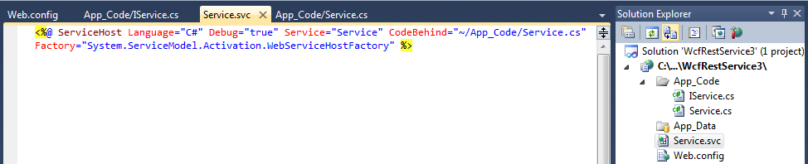
Service.svc needs to be modified: Add a line
You need to manually open the Service.svc Markup code and add one line of code, which adds RESTful service hosting model:
<%@ ServiceHost Language="C#" Debug="true" Service="Service" CodeBehind="~/App_Code/Service.cs" %>
Existing code
<%@ ServiceHost Language="C#" Debug="true" Service="Service" CodeBehind="~/App_Code/Service.cs"
Factory="System.ServiceModel.Activation.WebServiceHostFactory" %>
2

Slide 37
Remove SOAP Endpoint in Web.config
3
In the Web.config file, remove the entire <system.serviceModel> element, which will remove the SOAP endpoints.
RESTful services do not support the SOAP-endpoint-based access.
Removing this element will immediately disable the accesses from service proxies of all kinds of SOAP clients.
Open this file

Slide 38
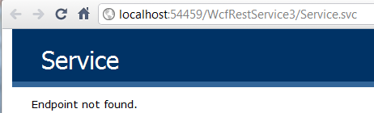
Accessing the Service over HTTP in a Browser
View the Service in Browser
http://localhost:54459/WcfRestService3/Service.svc/PiValue it returns: <double>3.1415926535897931</double>
http://localhost:54459/WcfRestService3/Service.svc/absValue?x=-27 it returns: <int>27</int>
http://localhost:49783/Service1/add2?x=15&y=17 → it returns: 32
Test the Deployed RESTful services in ASU Repository: PiValue, AbsValue, and add2 operations
http://venus.eas.asu.edu/WSRepository/Services/WcfRestService4/Service1/ http://venus.eas.asu.edu/WSRepository/Services/WcfRestService4/Service1/PiValue http://venus.eas.asu.edu/WSRepository/Services/WcfRestService4/Service1/AbsValue?x=-123 http://venus.eas.asu.edu/WSRepository/Services/WcfRestService4/Service1/add2?x=15&y=17

Slide 39
Accessing RESTful Service in a Program
Knowing the format of accessing the service
http://venus.eas.asu.edu/WSRepository/Services/RandomString/Service.svc/ GetRandomString/8
Construct the URL in the program
Base URL
Operation name
Parameters
Convert the return data to the required type
baseURL
Operation name
Parameter vale

Slide 40
Creating REST service URL in program Read: Text chapter 7 on RESTful Services
Notice how a RESTful service is access here
public class Service : IService {
public string GetRandomString(string myLength) {
// Create the base address to the RandomString service
Uri baseUri = new Uri("http://venus.eas.asu.edu/WSRepository/Services/RandomString/Service.svc");
// Define UriTemplate for passing parameter
UriTemplate myTemplate = new UriTemplate("GetRandomString/{Length}");
// Assign values to variable to obtain the complete URI
Uri completeUri = myTemplate.BindByPosition(baseUri, myLength);
WebClient channel = new WebClient(); // create a channel
byte[] abc = channel.DownloadData(completeUri); // return byte array
Stream strm = new MemoryStream(abc); // convert to mem stream
DataContractSerializer obj = new DataContractSerializer(typeof(string));
string randString = obj.ReadObject(strm).ToString();
return randString;
}

